Slide 1

Importance of Municipal Energy Mangement
Austrian Energy Agency
Gabriele Brandl | 24th of April 2019

Slide 2
Austrian Energy Agency
A link between business, administration and politics
Founded as a non-profit scientific association in 1977
Today: 84 employees| EUR 8.5 million turnover
Expertise and networking for politics, administration and business
The Presiding Committee is made up of
  the Federal Minister entrusted with the management of environmental affairs as president;
  the Federal Minister entrusted with the management of energy affairs as Vice-President;
  a provincial governor to be nominated by the provincial governors conference as vice president.
Members are the federal government, the federal states and more than 40 energy and social institutions
We provide solutions for the future of energy.

Slide 3



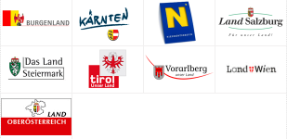

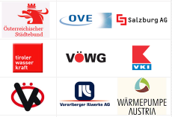
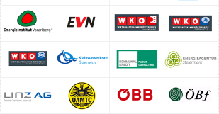



Our services At a glance
Consulting, research and training
Focus:
Energy policy and economic decisions and their implications
Austria| EU| International
AEA Academy (AEAc)
Networks
Program management
sovereign commission
*
*Monitoring body energy efficiency
We provide solutions for the future of energy.

Slide 4
Energy Partnerships with Bulgaria, Ukraine, Belarus, Czech Republic, Slovakia and Romania
Overall, the thematic content of the cooperation is focusing on the following topics:
sustainable, environmentally friendly and energy
efficient power supply systems,
efficient technologies for generating electricity (e.g.
cogeneration),
use of renewable energy sources (biomass, biogas, solar energy, hydropower and wind power), and
consumer-side energy efficiency measures
(especially in the area of power consumption).
We provide solutions for the future of energy.

Slide 5
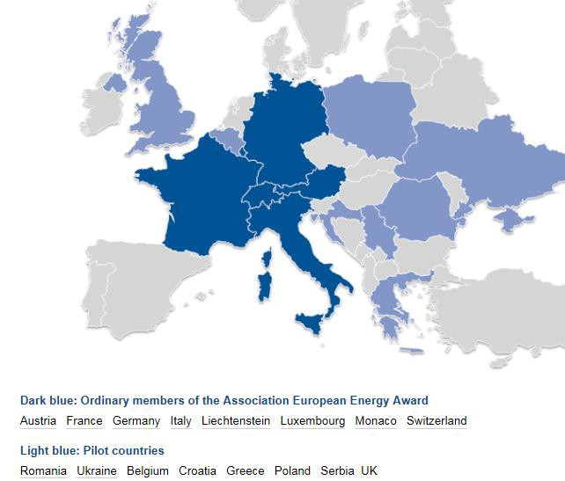

> 1,500 municipalities
Management system, including a standardised process which leads step by step to a sustainable energy/climate/mobility policy
Certification for municipalities with high efforts in local climate and energy topics
https://www.european-energy-award.org/
We provide solutions for the future of energy.

Slide 6

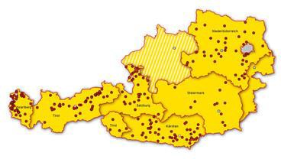

European Energy Award in Austria: e5 Programme
The e5-programme was launched in 1998
It provides municipalities with practical, long term support in the fields of energy efficienc and climate protection
The success of a municipality is measured in “e”s
The Austrian programme “e5 Österreich” is managed by the Austrian Energy Agency as part of the initiative “klimaaktiv” of the Austrian Federal Ministry for Sustainability and Tourism in cooperation with seven Austrian provinces.
-
y
https://www.e5-gemeinden.at/
We provide solutions for the future of energy.

Slide 7
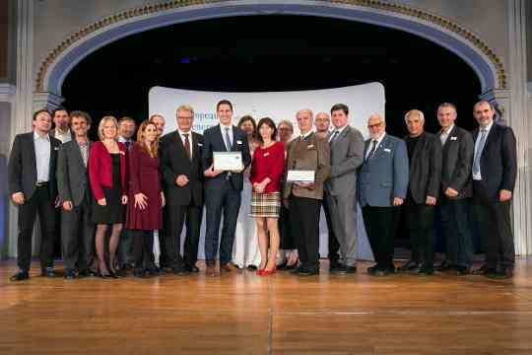
Award Ceremony, 5th of November 2018 in Baden, AT
Photo: BMNT/APA-Fotoservice https://www.klimaaktiv.at/bildgalerie/2018/european-energy-award.html
We provide solutions for the future of energy.

Slide 8

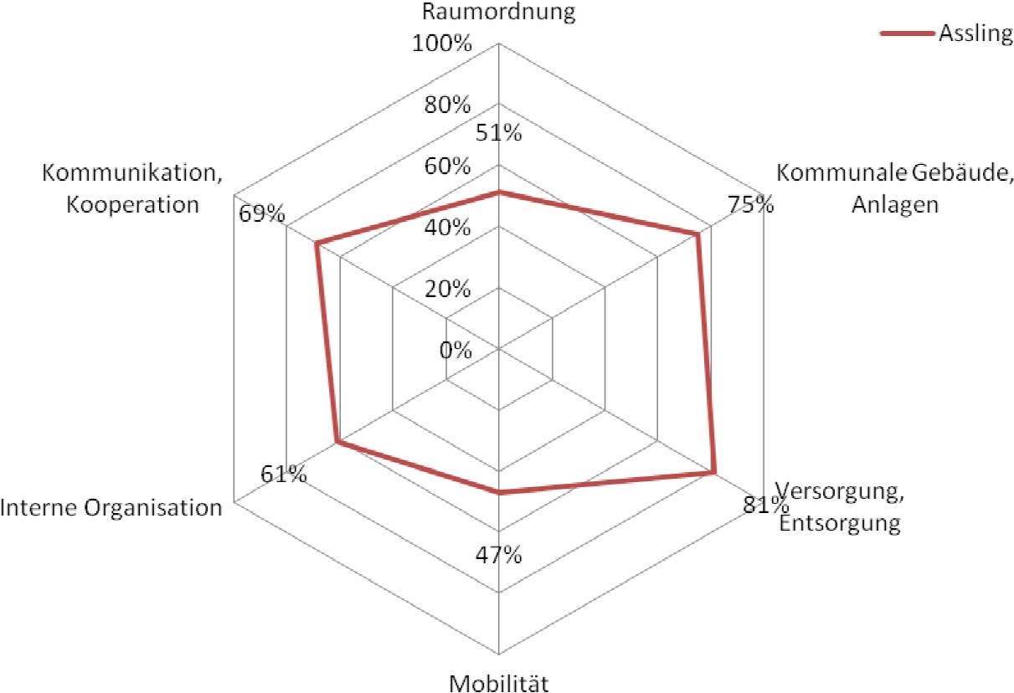
e5 - Gold Awarded Municiplaities
Assling
1,783 inhabitants
Tyrol
Source: Audit report 2015 e5 implementation
status
We provide solutions for the future of energy.

Slide 9
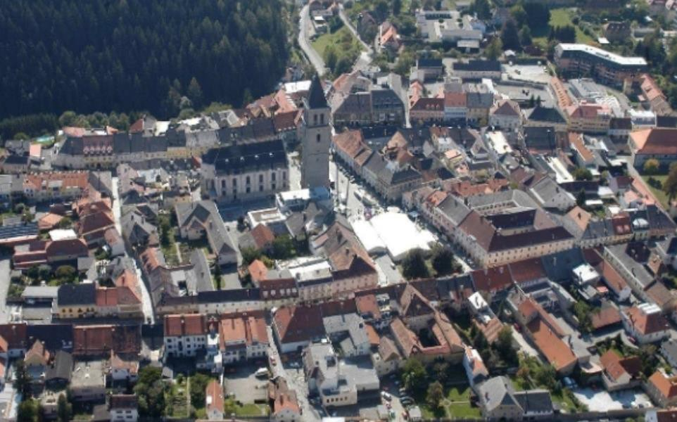
e5 - Gold Awarded Municiplaities
Judenburg
Styria
10,072 inhabitants
e5 since 2006
eg PV installation with public participation of citizens (https://www.judenburg.at/daten/ umwelt/Energiebericht_der_Stadt
_Judenburg_2013_.pdf)
Photo: © Gemeinde Judenburg
We provide solutions for the future of energy.

Slide 10
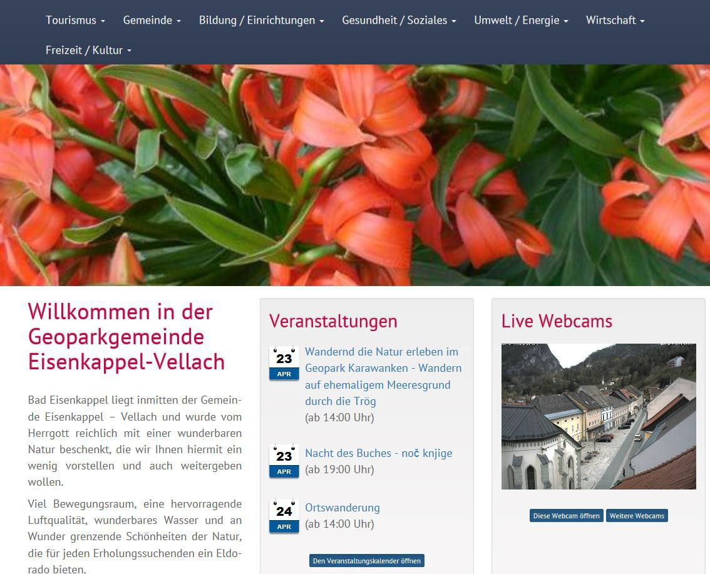
e5 - Gold Awarded Municiplaities
Eisenkappel-vellach/ Železna Kapla-Bela
Carinthia
2,346 inhabitants
e5 since 2010
eg LED ligthing
https://www.bad-eisenkappel.info/umwelt- energie/energieprojekte/musterprojekte.html
We provide solutions for the future of energy.

Slide 11
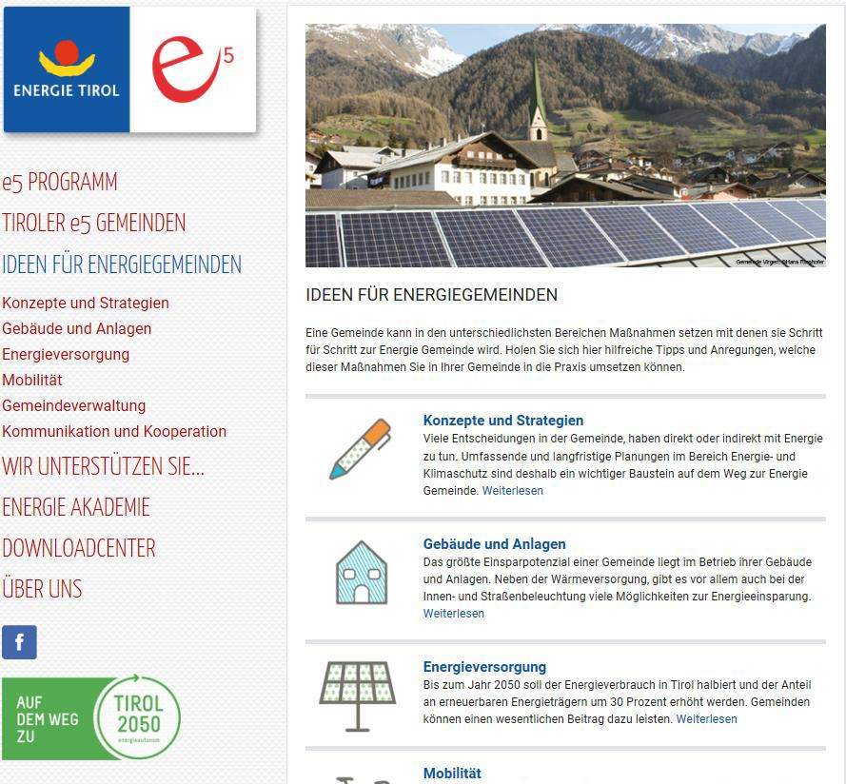
e5 - Gold Awarded Municiplaities
Virgen
Tyrol
2,186 inhabitants
e5 since 1999
http://www.energie-gemeinde.at/ideen-
fuer-energiegemeinden/
We provide solutions for the future of energy.
11

Slide 12
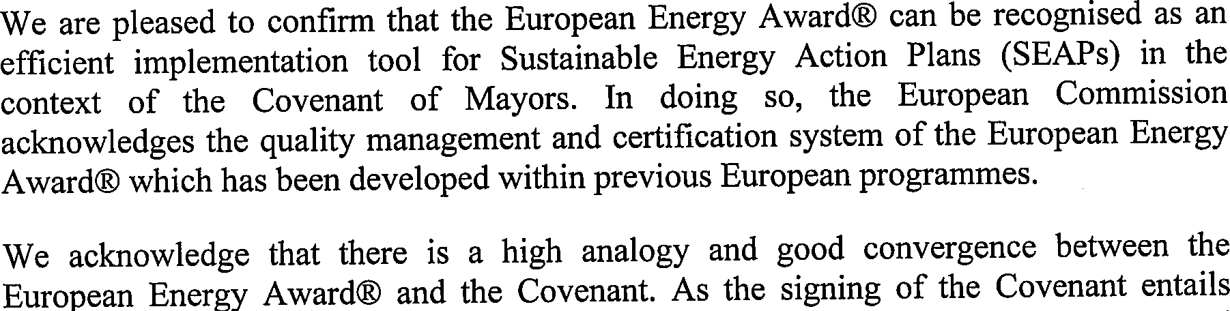


e5/eea and the “Covenant of Mayors”-Initiative
Letter of recognition as an "excellent implementation tool”
in the context of the Covenant of Mayor
Bildquelle: http://www.european-energy-award.org/home/
We provide solutions for the future of energy.
12

Slide 13


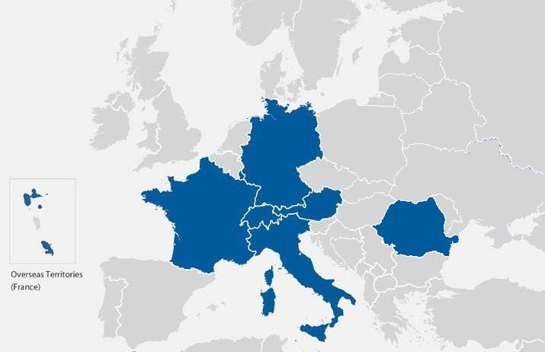
Project Description
This project has received funding from the European Union’s Horizon 2020 research and innovation
programme under Grant Agreement
No. 785033.
CoME EASY aims to promote, facilitate, support and extend the engagement of local public authorities on their pathway towards a sustainable and responsible energy and climate policy according to EU targets by combining forces of already existing strong energy and climate policy management approaches.
The project is carried out by an international consortium involving national managing structures and administrative offices of the eea, expert teams and 18 Ambassador Municipalities (AMs) that are already committed to the eea and will implement and test the new CoME EASY tools.
EEA managing authorities involved in CoME EASY municipalities in consortium EEA program
Austria | 233
France | 116
Germany | 329
Italy | 16
Luxembourg | 104
Switzerland | 637
Romania | 4
Total covered by consortiu | m 1439
total participating | 1456
% covered | 99%
13

Slide 14

European Energy Award in Bulgaria
Feasibility Study done
Test Phase (6-12 months)
1-3 Cities/Municipalities
getting familiar with the main elements of e5/eea
test of the EMT Tool (english version)
Coached by an eea advisor
https://www.european-energy-award.org/
We provide solutions for the future of energy.
14

Slide 15


Contact
Gabriele Brandl
Austrian Energy Agency
gabriele.brandl@energyagency.at
Tel 0043 1 586 15 24 - 185 | Mob 0043 664 618 02 89
Mariahilfer Strasse 136 | 1150 Vienna | Austria
www.energyagency.at
@at_AEA
In the podcast Petajoule, the experts of the Austrian Energy Agency will be answering questions to the
energy future with guests from the energy sector.
The Austrian Energy Agency is ÖNORM ISO 50001:2011 and ISO 29990:2010 certified.

